Slide 1
Machine Learning
South Fayette Pilot

Slide 2
Selling your idea
In the weighted majority algorithm, we learned about online learning which can take multiple datapoints and adjust weights so that it can predict which friend may have the closest tastes in movies to your own.
Now let’s look at a different applications of weights.

Slide 3

Selling your idea
Problem:
How would one classify this handwritten digit? It’s not very well written and the resolution of the image is low.

Slide 4

Selling your idea
You can look at this from pixel values.
The image is composed of 28 x 28 pixels.
28
28

Slide 5


Selling your idea
But look at these others.
It seems fairly obvious to the human eye and brain that these are all “4” but the pixel values are very different. The neurons firing for “4” are different than the others but the brain understands them all the same.
=
=
!=

Slide 6
Selling your idea
The algorithm we will use, a neural network
will take in the 28x28 grid of pixels, stack them into an array and output a prediction of class 0-9
28
0
1
2
3
4
5
6
7
8
9
Neural
Network
28

Slide 7
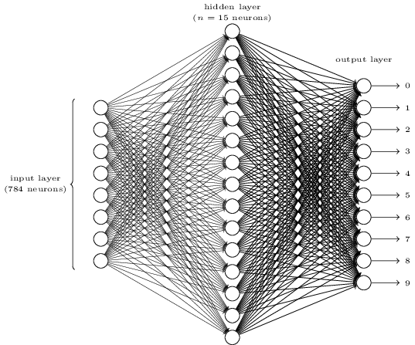
Let’s see what a neural network actually is and how it actually makes this prediction.
28
28

Slide 8
The hope is that you will understand the structure and the intuition and reason why they work.
28
28

Slide 9
On a broad level, neural networks are composed of layers of neurons.
28
1
a layer
28
a neuron
784

Slide 10
The hope is that after the 784 pixels go into the
28
1
a layer
28
a neuron
784

Slide 11


1. Intro
Choose one approach to grab the audience’s attention right from the start: unexpected, emotional, or simple.
Unexpected Highlight what’s new, unusual, or surprising.
Emotional Give people a reason to care.
Simple Provide a simple unifying message for what is to come

Slide 12
How many languages do you need to know to communicate with the rest of the world?
Tip
In this example, we’re leading off with something unexpected.
While the audience is trying to come up with a number, we’ll surprise them with the next slide.

Slide 13
Just one! Your own.
(With a little help from your smart phone)
Tip
Remember. If something sounds like common sense, people will ignore it.
Highlight what is unexpected about your topic.

Slide 14

The Google Translate app can repeat anything you say in up to NINETY LANGUAGES from German and Japanese to Czech and Zulu
Tip
Don’t wait till the end of the presentation to give the bottom line.
Reveal your product or idea (in this case a translation app) up front.

Slide 15
2. Examples
By the end of this section, your audience should be able to visualize:
What What is the pain you cure with your solution?
Who Show them a specific person who would benefit from your solution.

Slide 16
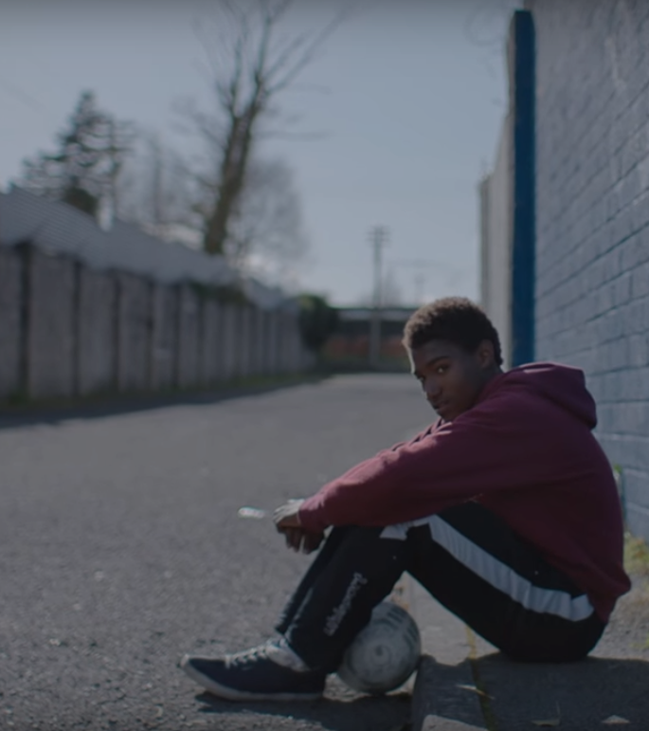
Meet Alberto.
He recently moved from Spain to a small town in Northern Ireland.
He loved soccer, but feared he had no way to talk to a coach or teammates.
Tip
Tell the audience about the problem through a story, ideally a person.

Slide 17

Meet Marcos.
He recently opened a camera shop near the Louvre in Paris.
Visitors to his store, mostly tourists, speak many different languages making anything beyond a simple transaction a challenge.
Tip
If one example isn’t sufficient to help people understand the breadth of your idea, pick a couple of examples.
Story for illustration purposes only

Slide 18
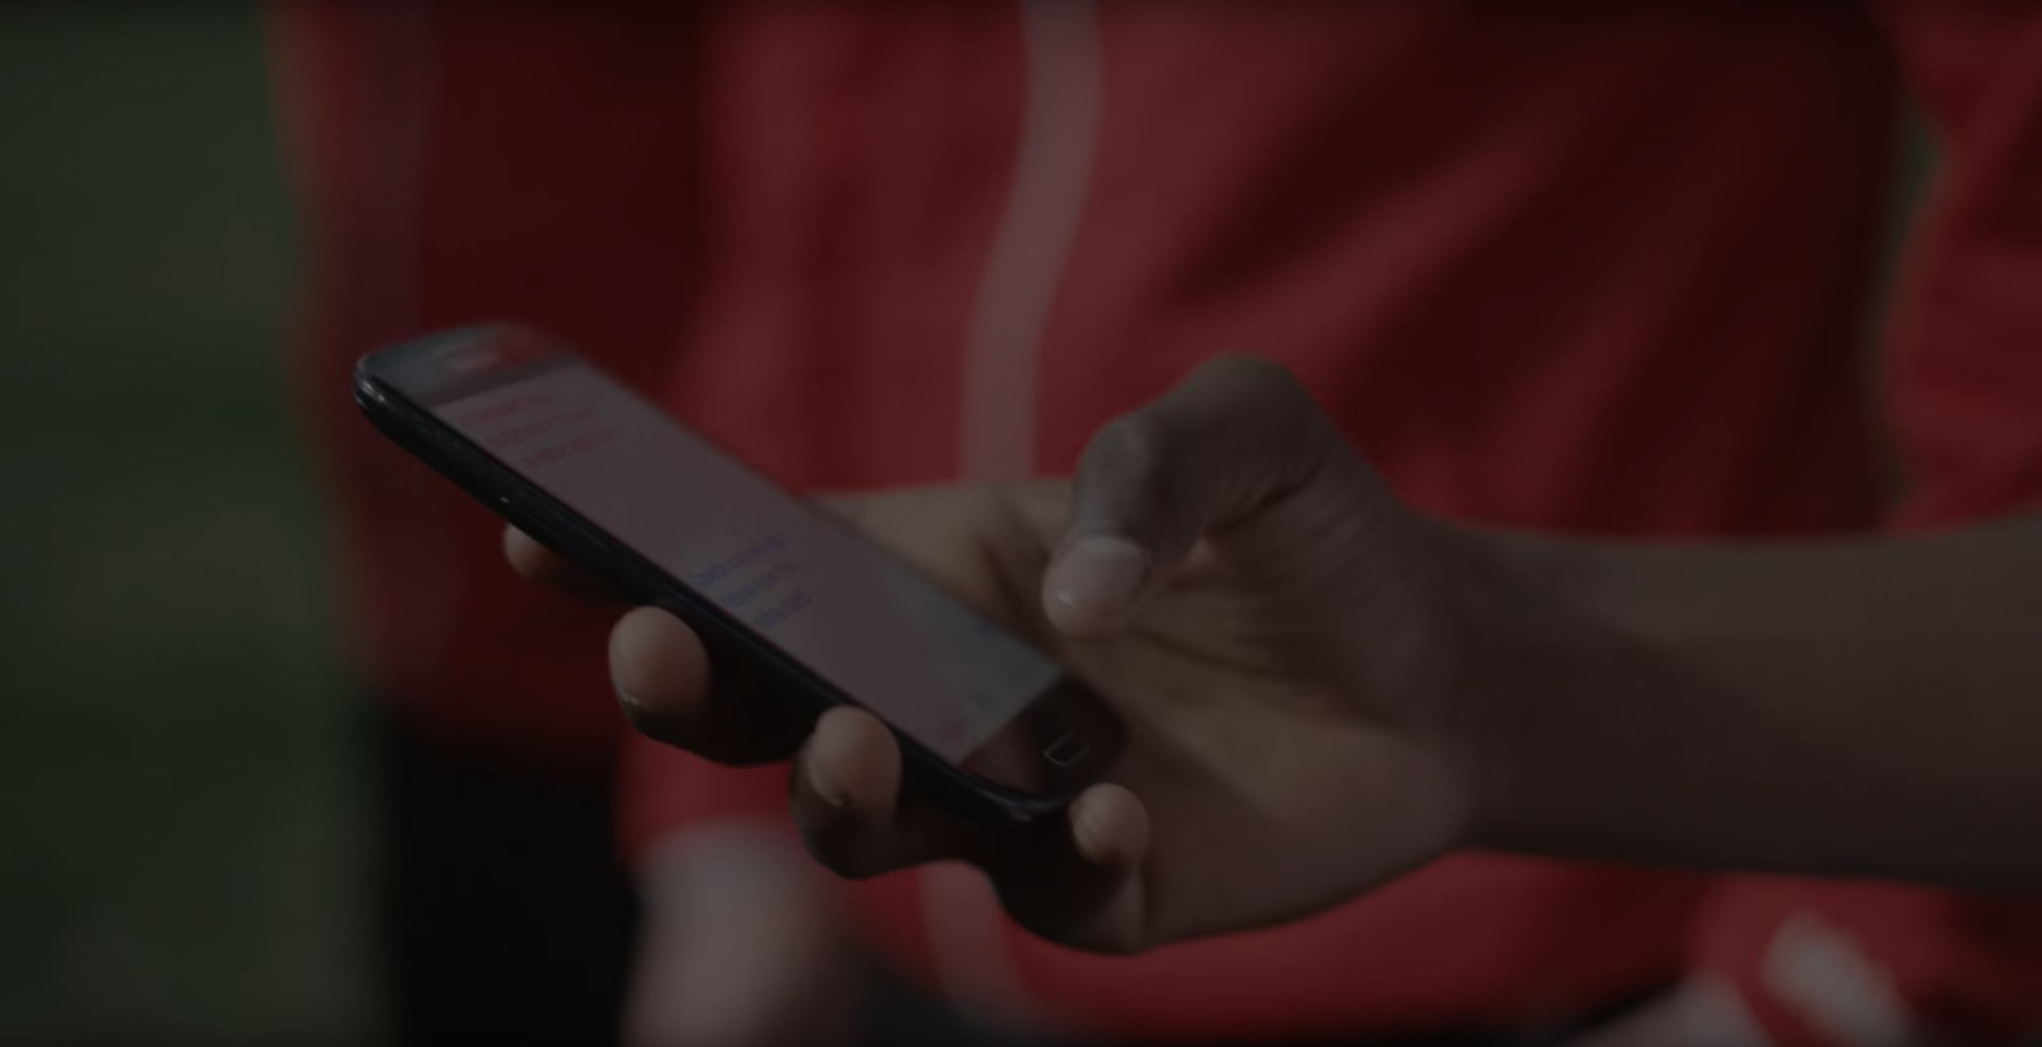
A translation barrier left Alberto feeling lonely and hurt Marco’s business.
Tip
Ideally, speak of people in very different situations, but where each could benefit from your solution.

Slide 19

Then, Marcos discovered Google Translate
He has his visiting customers speak their camera issues into the app.
He’s able to give them a friendly, personalized experience by understanding exactly what they need.

Slide 20
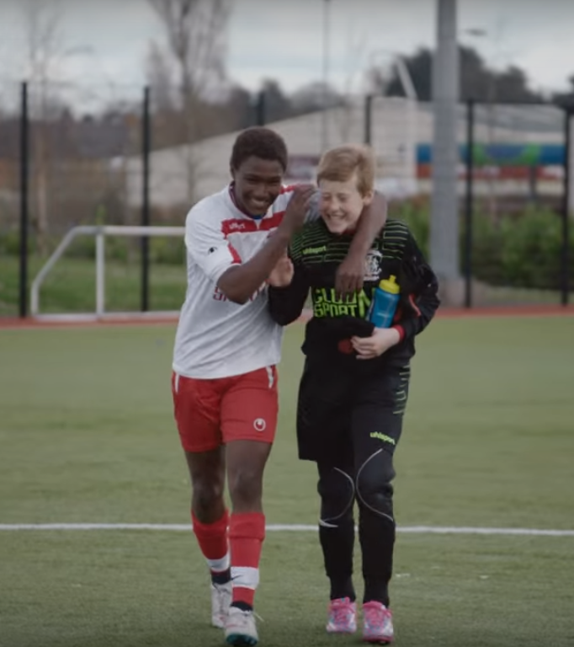
A simple gesture
Coaches Gary and Glen knew no Spanish.
They used Google Translate to invite Alberto to join in... “Do you want to play?”... “Can you defend the left side?”
Tip
Show how your solution helps the person in the story reach his or her goals.

Slide 21

From outsider to star
Alberto scored 30 goals in 21 games. He is now being scouted by several professional clubs in the Premier League. And he’s a favorite of the other boys on the team.
See a short video on Alberto’s story
Tip
Stories become more credible when they use concrete details such as the specific complex moves Alberto learned through Translate and his 30 goals in 21 games performance stats.

Slide 22
3. Examples
People need to understand how rare or frequent your examples are.
Pick 1 or 2 statistics and make them as concrete as possible. Stats are generally not sticky, but here are a few tactics:
Relate Deliver data within the context of a story you’ve already told
Compare Make big numbers digestible by putting them in the context of something familiar

Slide 23
It’s no surprise Marcos uses Google Translate in his shop regularly.
There are 23 officially recognized languages in the EU.
Tip
Don’t let data stand alone. Always relate it back to a story you’ve already told, in this case, Marco’s shop.
Source: theguardian.com

Slide 24


More than 50 million Americans travelled abroad in 2015
THAT’S MORE THAN THE POPULATION OF
CALIFORNIA AND TEXAS COMBINED
Tip
When a number is too large or too small to easily comprehend, clarify it with a comparison to something familiar.
Source: travel.trade.gov

Slide 25
4. Closing
Build confidence around your product or idea by including at least one of the these slides:
Milestones What has been accomplished and what might be left to tackle?
Testimonials Who supports your idea (or doesn’t)?
What’s next? How can the audience get involved or find out more?

Slide 26
Milestones
October 2014
October 2015
August 2015
November 2015
Translate web pages with Chrome extension
Translate text within an app
2014 |  |  |  | 2015
Translate conversations through your Android watch
Translate written text from English or German to Arabic with the click of a camera

Slide 27
What people are saying
With this app, I’m confident to plan a trip to rural Vietnam
Wendy Writer, CA
Visual translation feels like magic
Ronny Reader, NYC
Translate has officially inspired me to learn French
Abby Author, NYC
Quotes for illustration purposes only

Slide 28

Know a 2nd language? Make Google Translate even better by joining the community.
Tip
Inspire your audience to act on the information they just learned.
Depending on your idea, this can be anything from downloading an app to joining an organization.

Slide 29

Good luck!
We hope you’ll use these tips to go out and deliver a memorable pitch for your product or service!
For more (free) presentation tips relevant to other types of messages, go to heathbrothers.com/presentations
For more about making your ideas stick with others, check out our book!

